Slide 1
illumicloud
UO GEOG 496 S18
prototype
by Theodore Lessman
A Citizen Science App for Mapping Illuminance

Slide 2







illumicloud
How is light used in daily life?
Light:
allows us to see…
provides safety and security…
gives us warmth…
reveals that which is hidden…
is captured for energy in photosynthesis… photovoltaic energy…
provides human interaction for entertainment… communication…

Slide 3


illumicloud
How does light occupy space?
1000 lumen / 1m = 1000 lux
Light:
radiates from a source of energy
travels in a direct line
has a luminous flux or total power from the source (lumens)
has a luminous intensity on an area of one lumen per square meter (lux)
The spatial intensity is inversely proportional to the total power
can be reflected, scattered or blocked by objects or particles
1000 lumen / 100m = 10 lux

Slide 4

illumicloud
What is illumicloud?
illumicloud is a Javascript web application prototype that aims to utilize the power of the crowd to map illuminance both spatially and temporally, in order to provide more accurate representations of lighting across space and time.
The data produced can be used in multiple real-world applications, from improving well-lit path analyses and safe walk routing to measuring the extent of light pollution affecting both natural and developed ecosystems.

Slide 5
illumicloud
Technical Specifications
App Design:
Requires a modern smartphone with ambient light sensor and GPS (iPhone, Android)
Web app allows cross platform compatibility
Prototype developed for Firefox 60.x
Data Product:
Obtains geolocation in real-time
Light sensor readings in regular intervals
Timestamps for isolating light and traffic patterns across a time-series.
Protects location privacy by omitting user and device ID
Field | Id | Timestamp | Lat | Long | Lux
Datatype | Number | String (ISO Date Object) | Float | Float | Number
Example | 1 | “20180613T132716Z” | 44.047 | -123.076 | 240.0

Slide 6
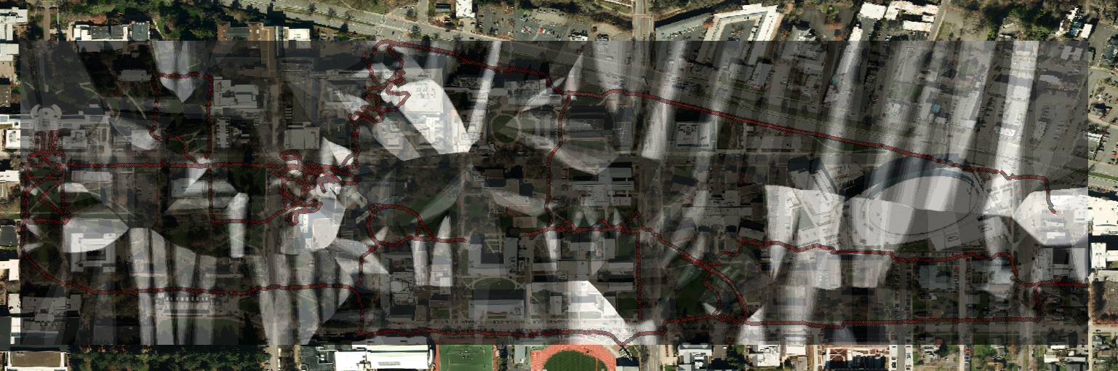
illumicloud
Activities Performed
Data Collection:
User opens goes to https://illumicloudjs.appspot.com
User allows location services
User presses “record”
User walks with phone light sensor exposed
As user passes light sources, illuminance data (lux) is collected
User presses “pause”
User presses “export”
A text file is downloaded
Analysis:
Analyst ensures data is tidy (‘\n’ replaces ‘;’)
Points can be filtered by time or sensor reading threshold, then interpolated to create an illuminance surface.

Slide 7
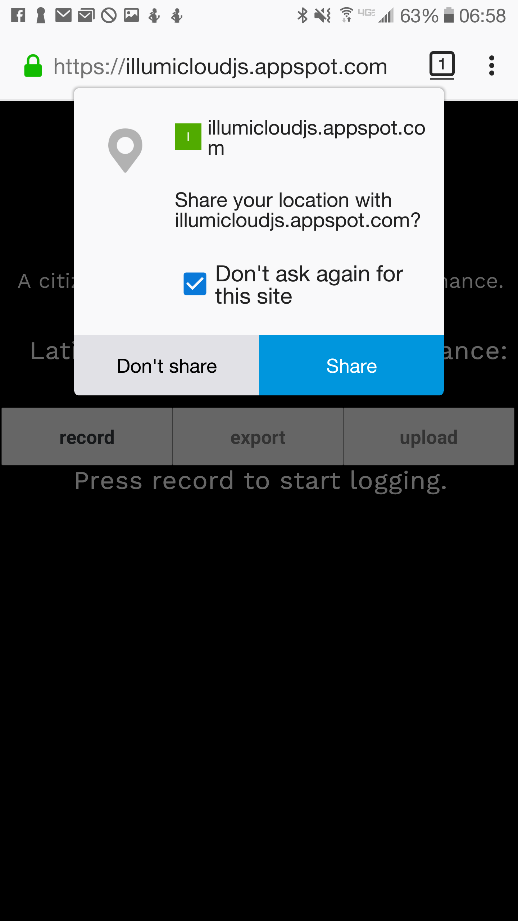
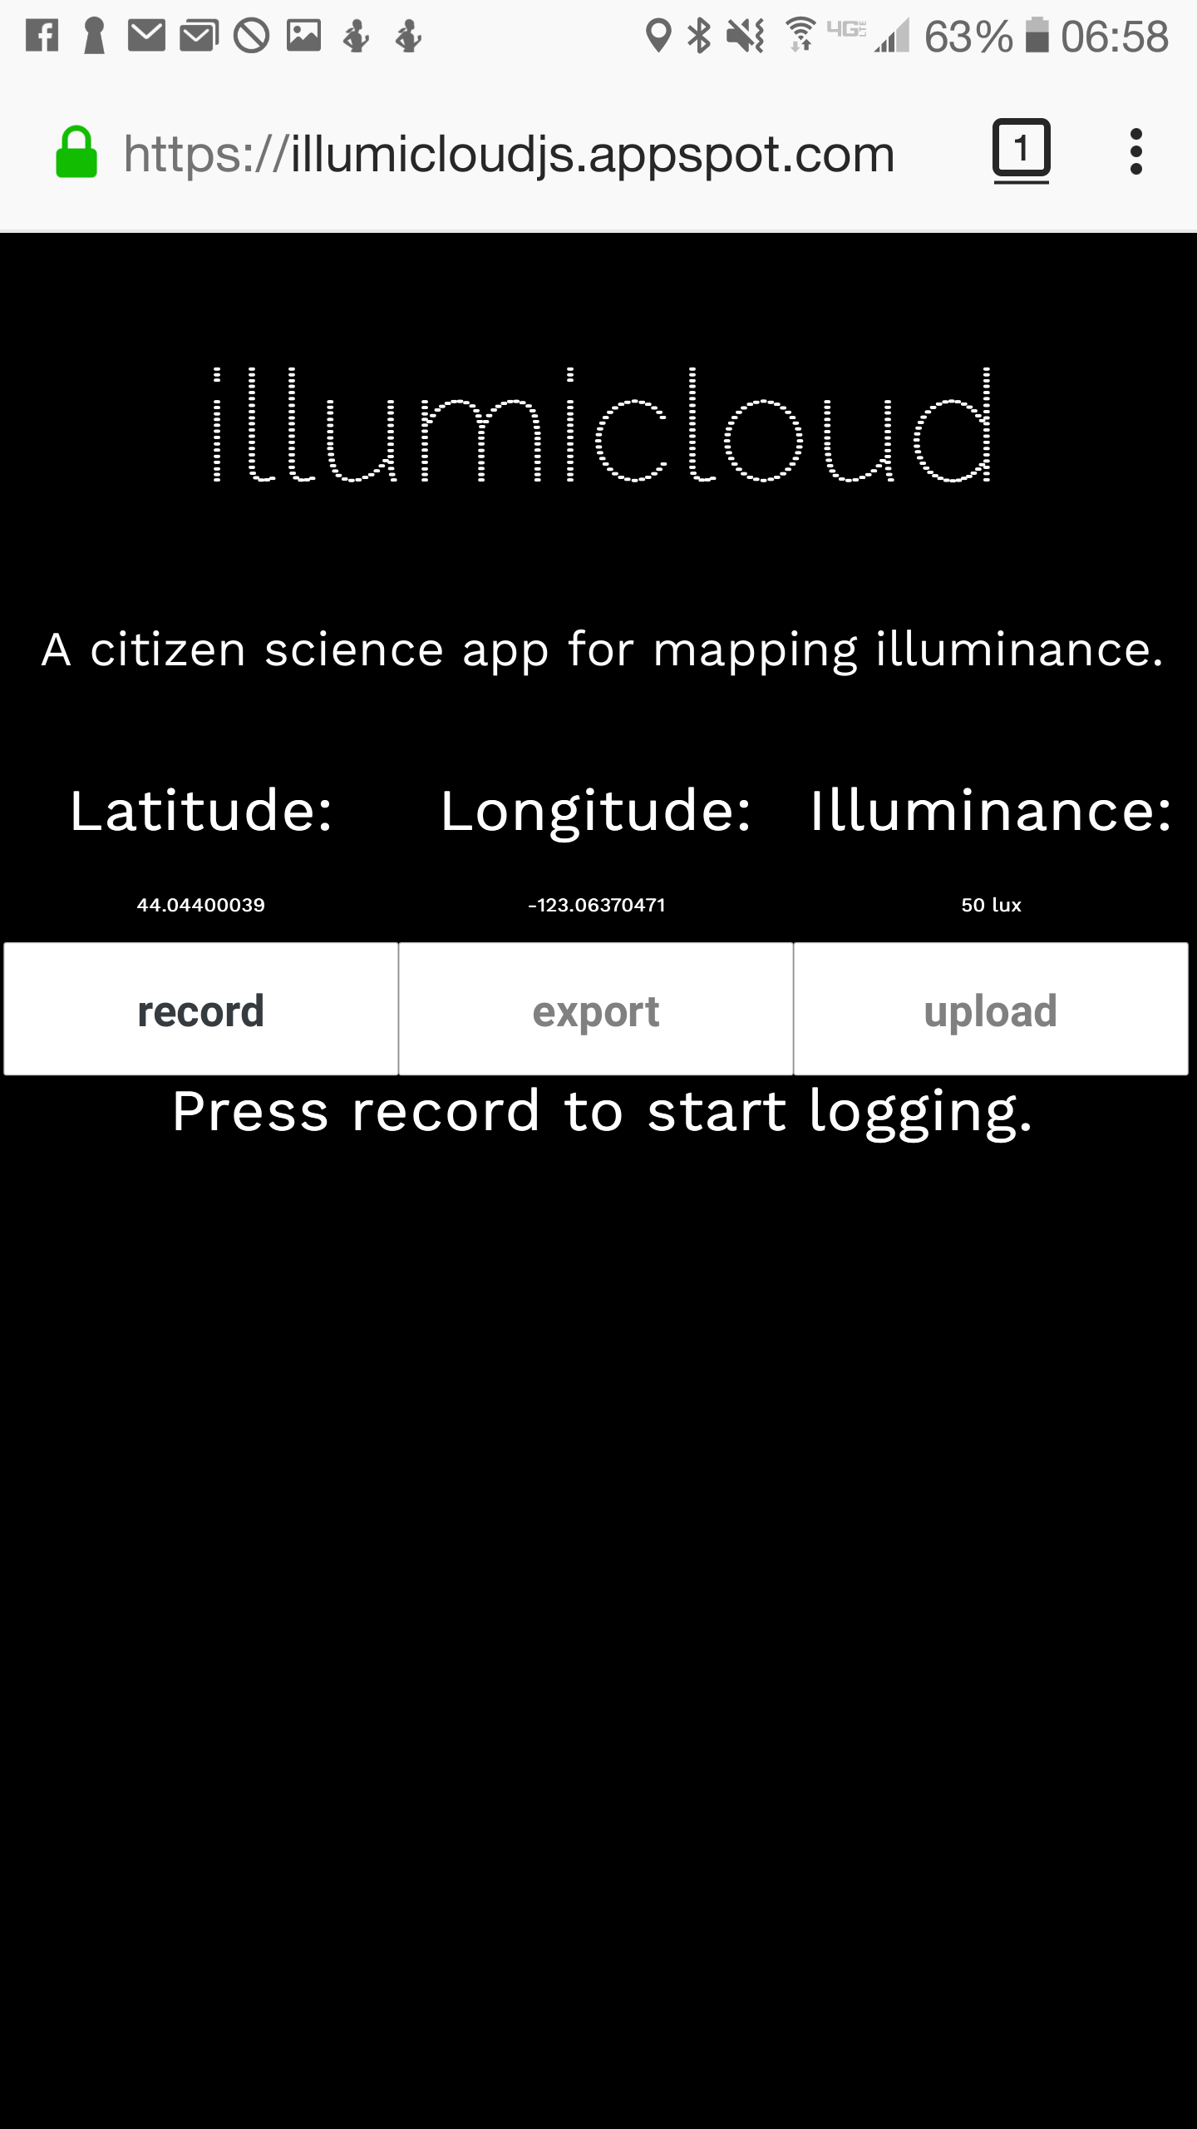
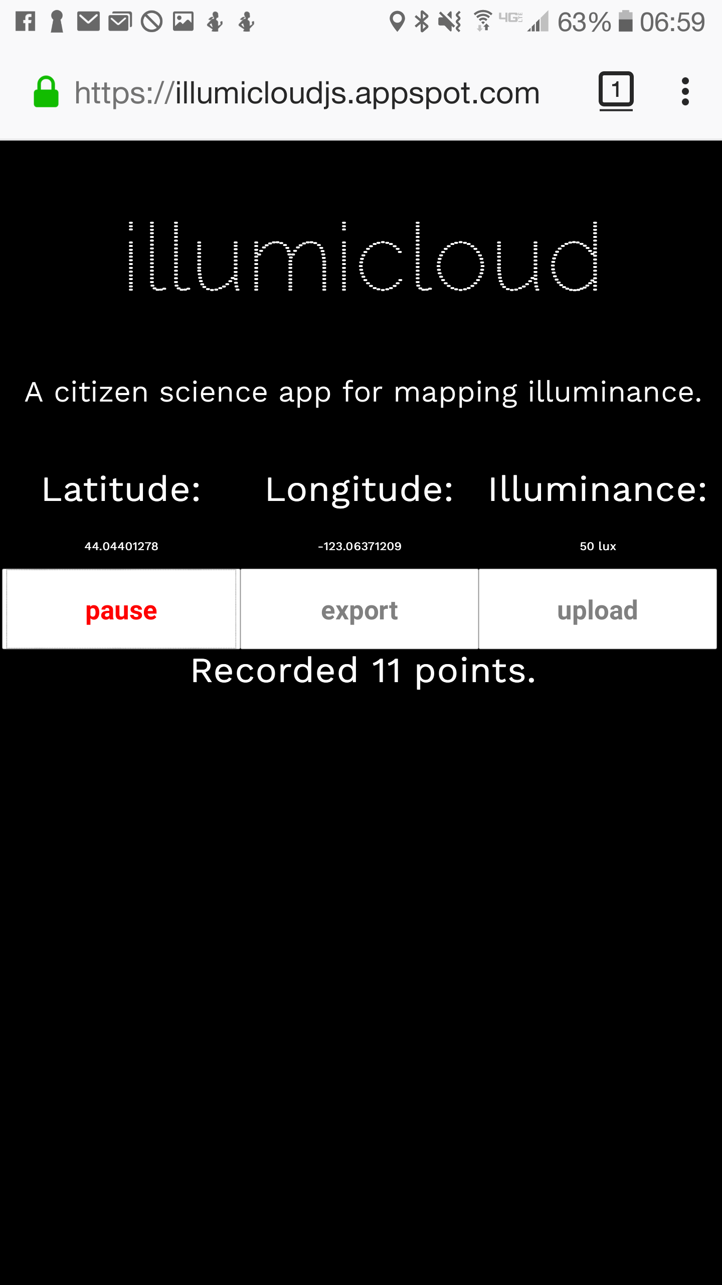
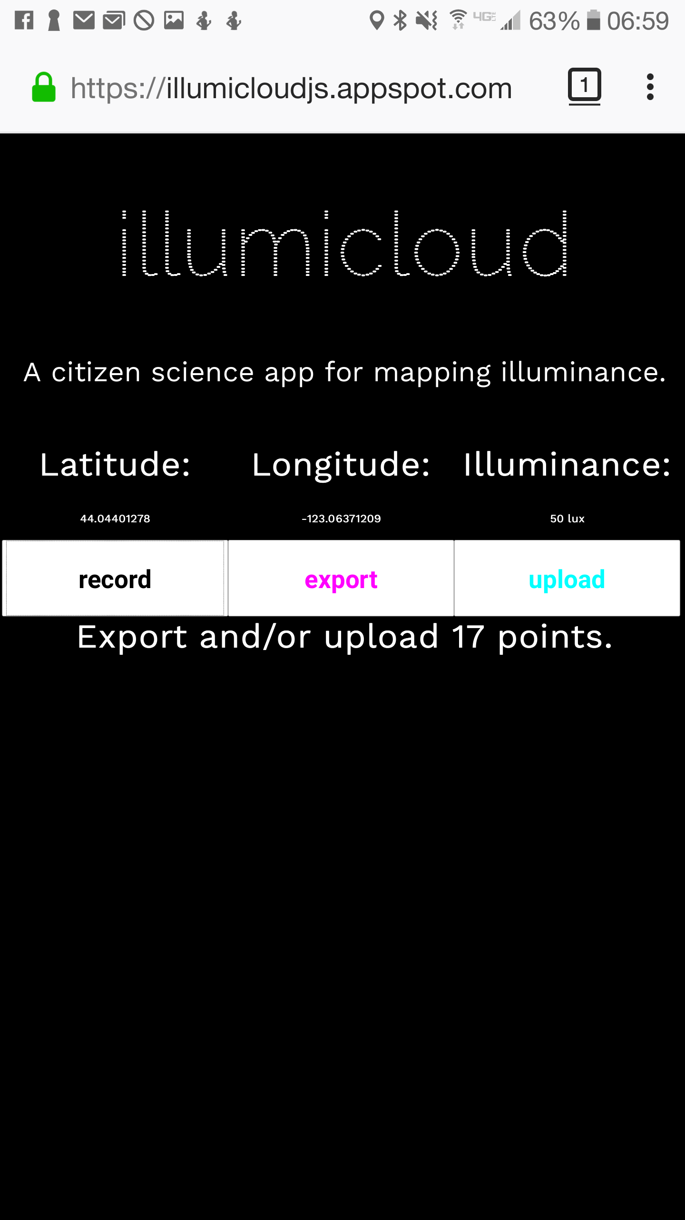
illumicloud
Application Storyboard
Location Permission
Geolocation and Ambient Light Sensor Reporting
“record” pressed and record count begins incrementing
“pause” pressed then “export” and “upload” are available

Slide 8
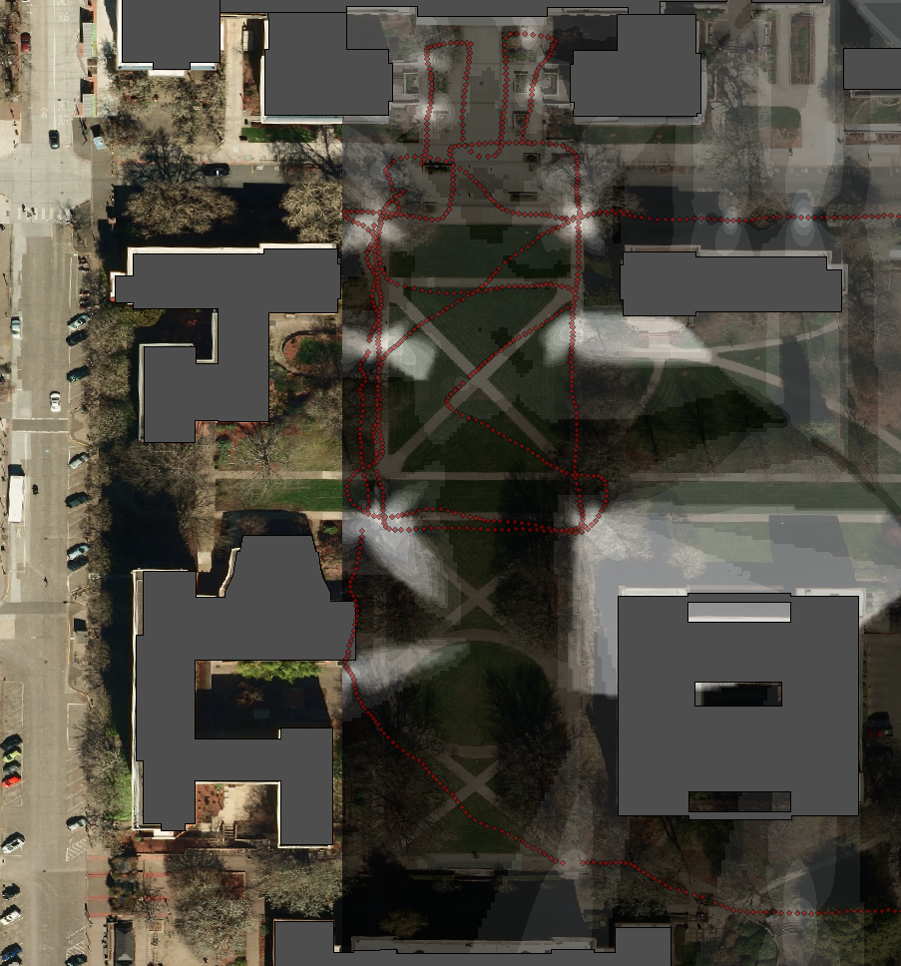
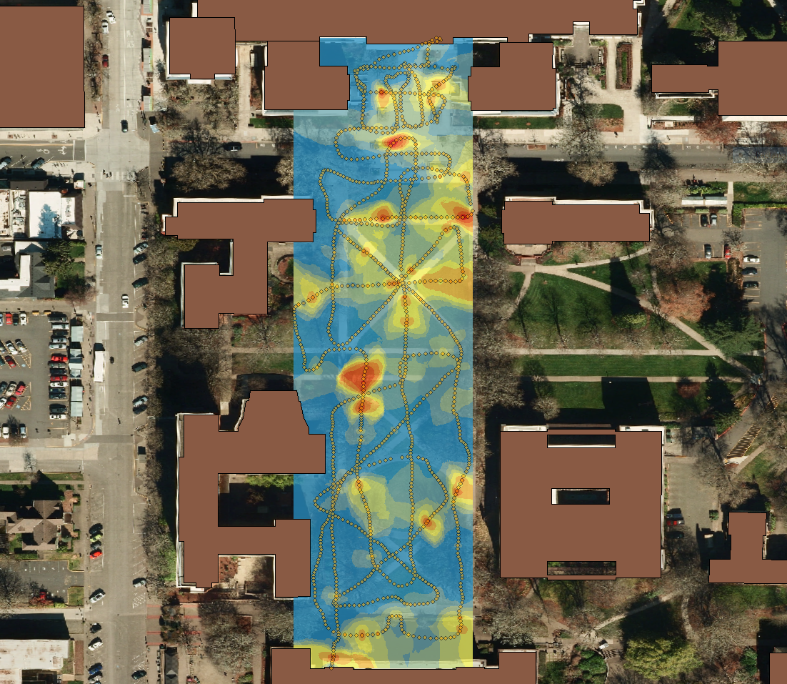
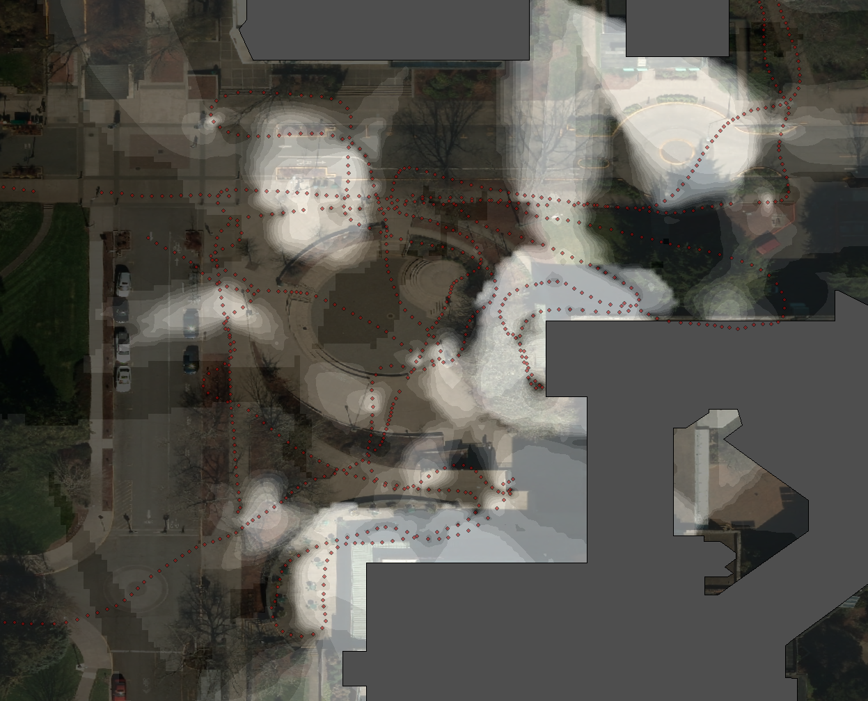
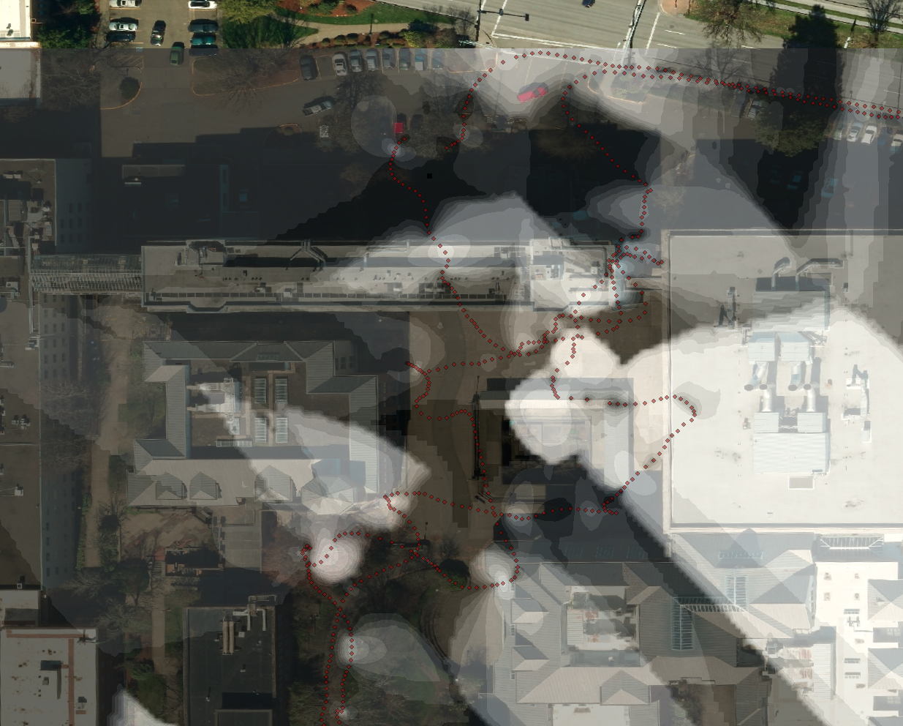
illumicloud
Preliminary Analysis
Data analyzed using ArcPy in Python
Data is cleaned up and exported into SHAPEFILE
Inverse Distance Weighted interpolation analysis performed in ArcMap to predict values between points
Data from illumicloud. interpolated in ArcMap. Clockwise from top left: quadrangle by Condon night, day, EMU night, Onyx night
Basemap Data Source: City of Eugene 2013

Slide 9
illumicloud
Progress and Projected Outcomes
Realized Outcomes:
Location-aware prototype
Updated designs and documentation
Downloadable text format for development phase testing and analysis
Analysis of preliminary data providing proof of concept
Upcoming features to be developed:
Implementation of server-side database
Web map depicting location tracking graphically in real-time
Support for more browsers and devices.
Future-proofing of app using AmbientLightSensor in new Generic Sensor API module
Refinements to UI/UX

Slide 10
illumicloud
Thank you.
prototype
Citizen Science App for Mapping Illuminance

